Slide 1
PET PARADISE
ONLINE PET SHOP

Slide 2
AGENDA
Introduction
Problem Statement
Proposed Solution
System Architecture Diagram
Output Images
GITHUB LINK
Conclusion
Reference

Slide 3
Customers now have difficulties while attempting to acquire pets from any pet store, including the onerous task of physically hunting for pet stores, which may or may not satisfy customer needs. We provide a method for purchasing dogs online by utilising web technology and creating an interactive website.
The purchase of pets was made possible by a website application named petz-paradise online pet shop. The individuals can thus rely on other people to help them buy a variety of pet breeds. Additionally, people could become aware of the varied price ranges at which the same breed is sold.
INTRODUCTION

Slide 4
PROBLEM STATEMENT
Majority of the people still rely on local markets and dealers for buying their desired pets whereas a part of the money is to be sent to agents as commission.
Currently the number of active mobile applications found in our area that provides purchase of pets are very limited
Many applications are available in foreign countries like USA, but it is rarely developed in our area.
Proper and timely updating of data is not done in many such applications and therefore it is not recommended to use.
Similarly, lack of good user interface is a main problem in these cases

Slide 5
Proposed Solution
Enhancement:
The Pet ShopManagement System's major goal is to improve and modernize the current system by raising its efficacy and efficiency.
Automation:
The manual system's throughput is increased by the pet shop management system by automating all of its manual tasks.
User Friendly:
A very user-friendly interface may be found on the pet Shop Management System . Users will therefore find it quite simple to utilize.

Slide 6
Proposed Solution
Availability:
Retries of the system's transaction reports are possible as needed. As a result, information is always available and can be swiftly and simply collected,
Security:
This is a crucial component of the design that must consider like hardware dependability, backup plans, physical protection of the data.
System design:
The hardware reliability, fallback mechanisms, physical protection of the data, and the provision for fraud and abuse detection are all areas that should be covered by this crucial design element.

Slide 7
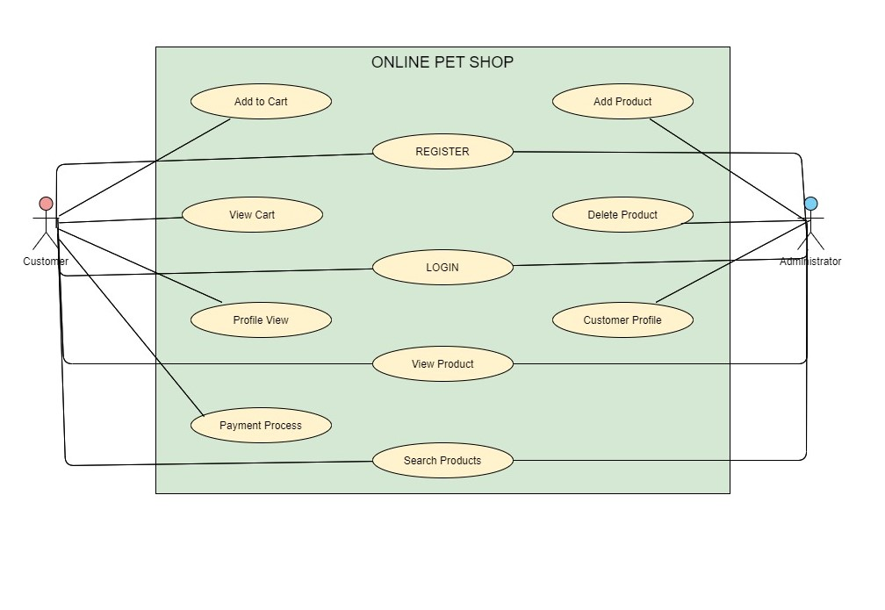
System Architecture USE CASE DIAGRAM

Slide 8
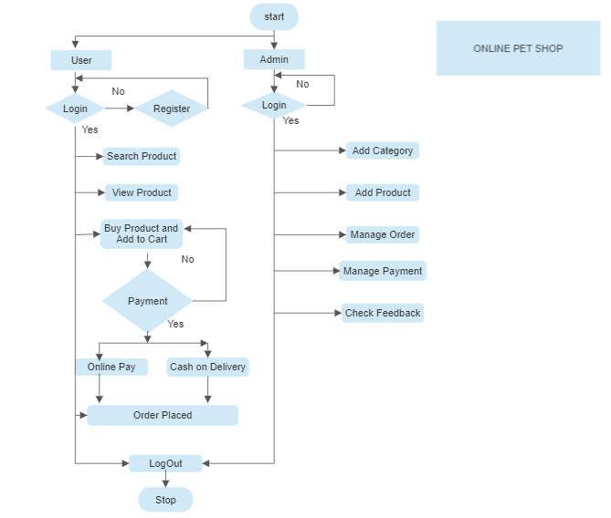
System Architecture flow chart

Slide 9
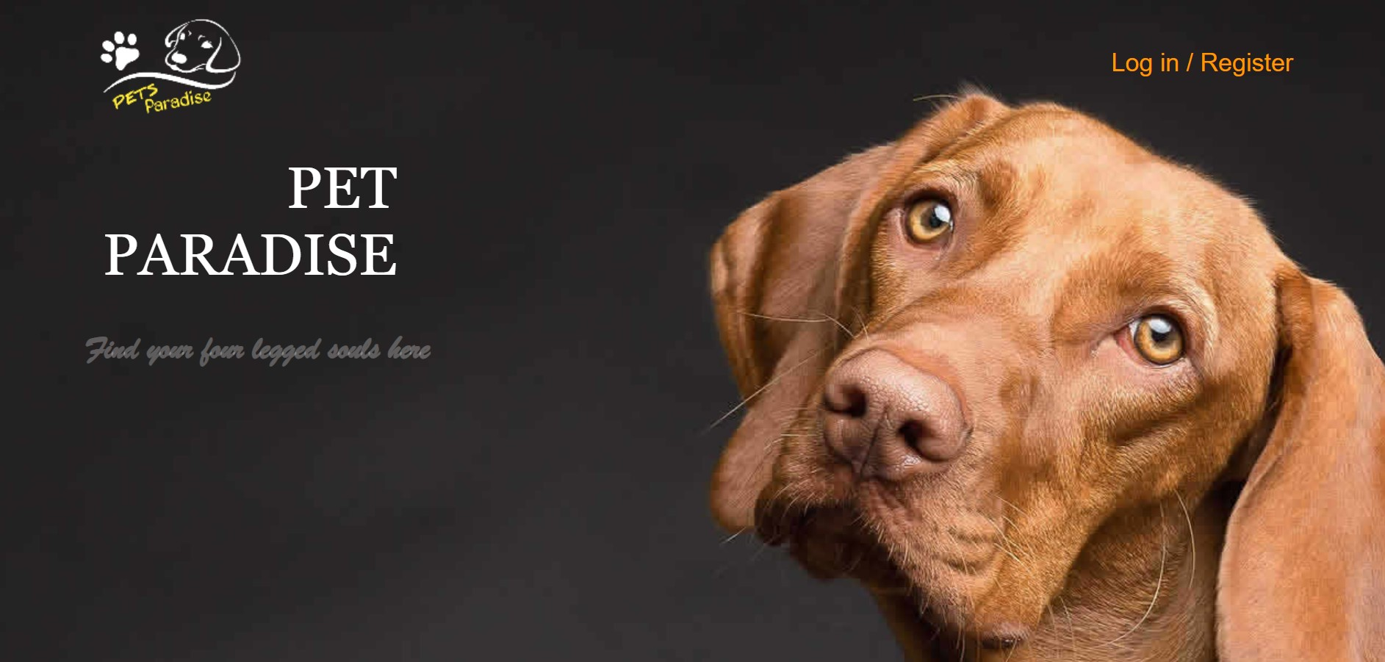
OUTPut IMAges

Slide 10
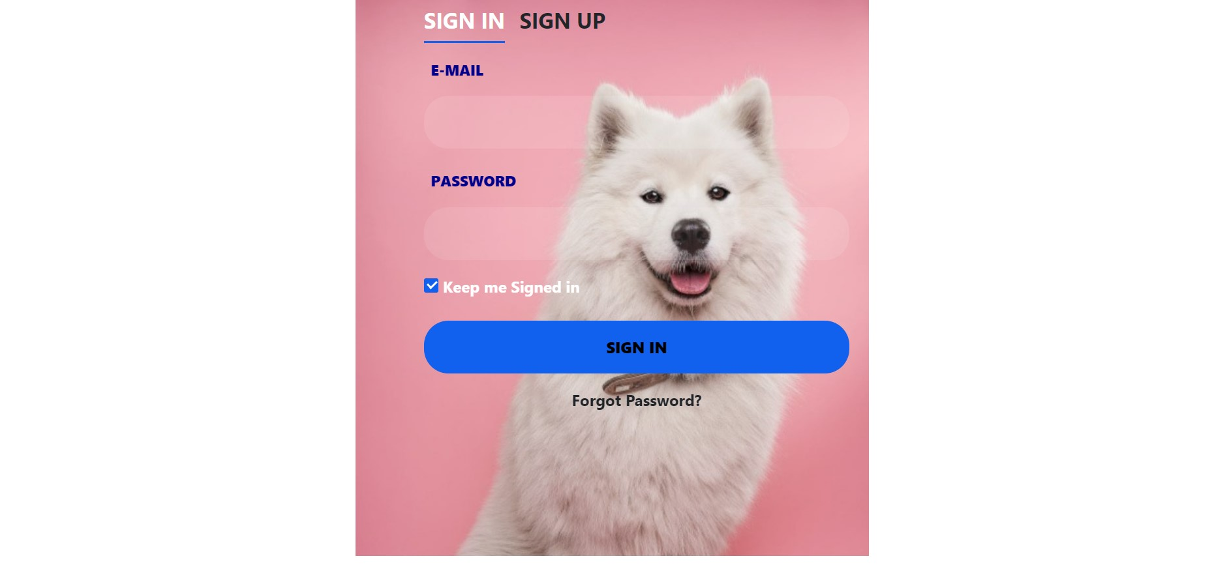
Output Image's

Slide 11
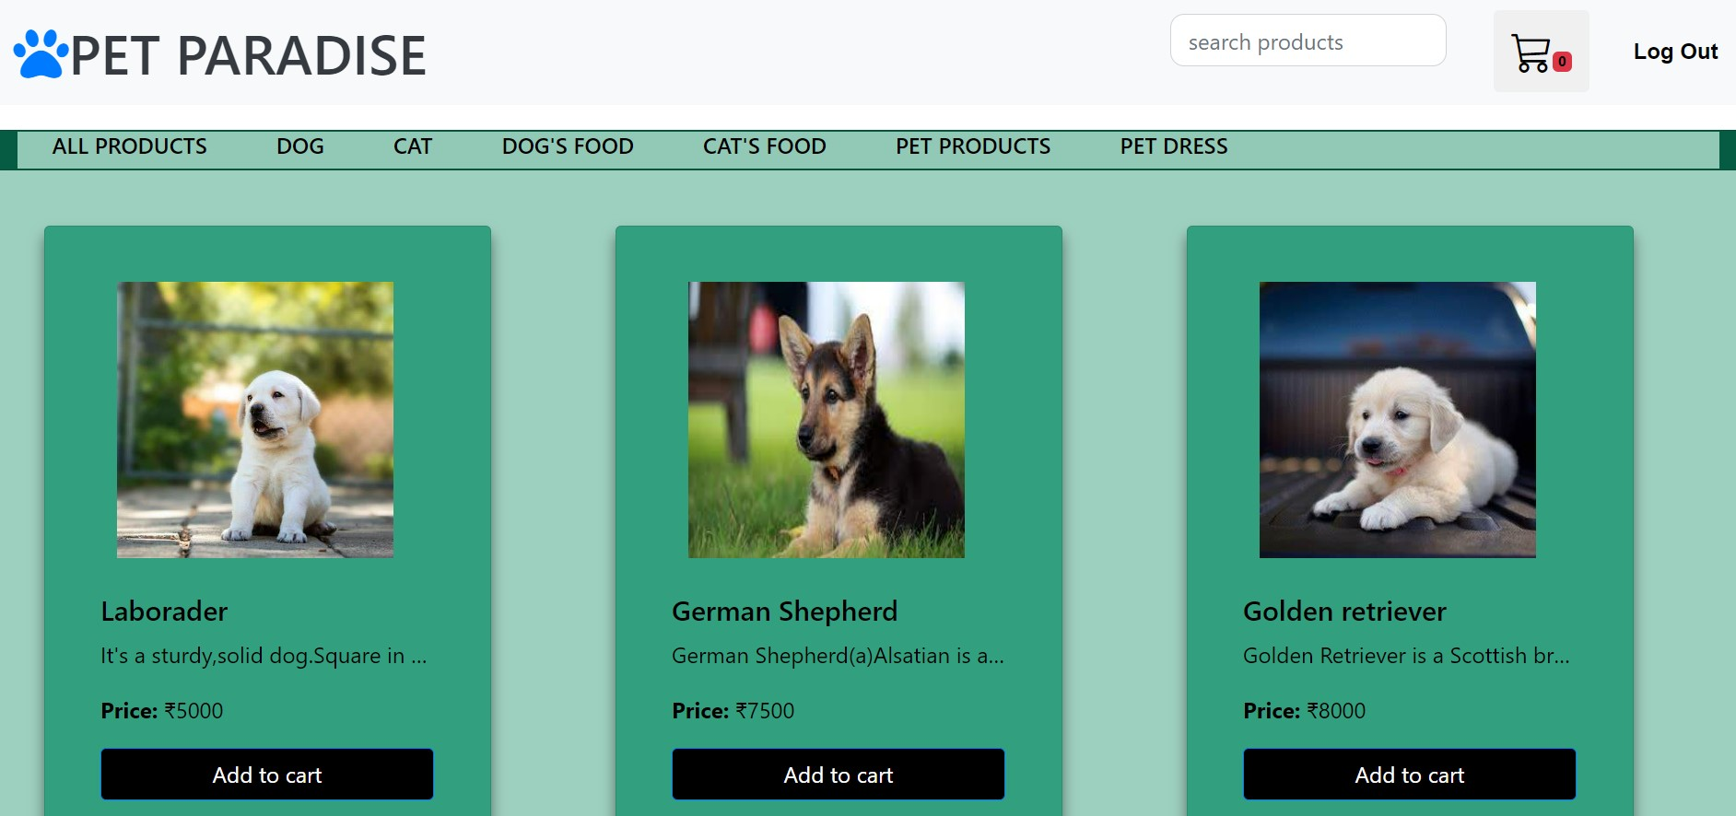
Output Image's

Slide 12
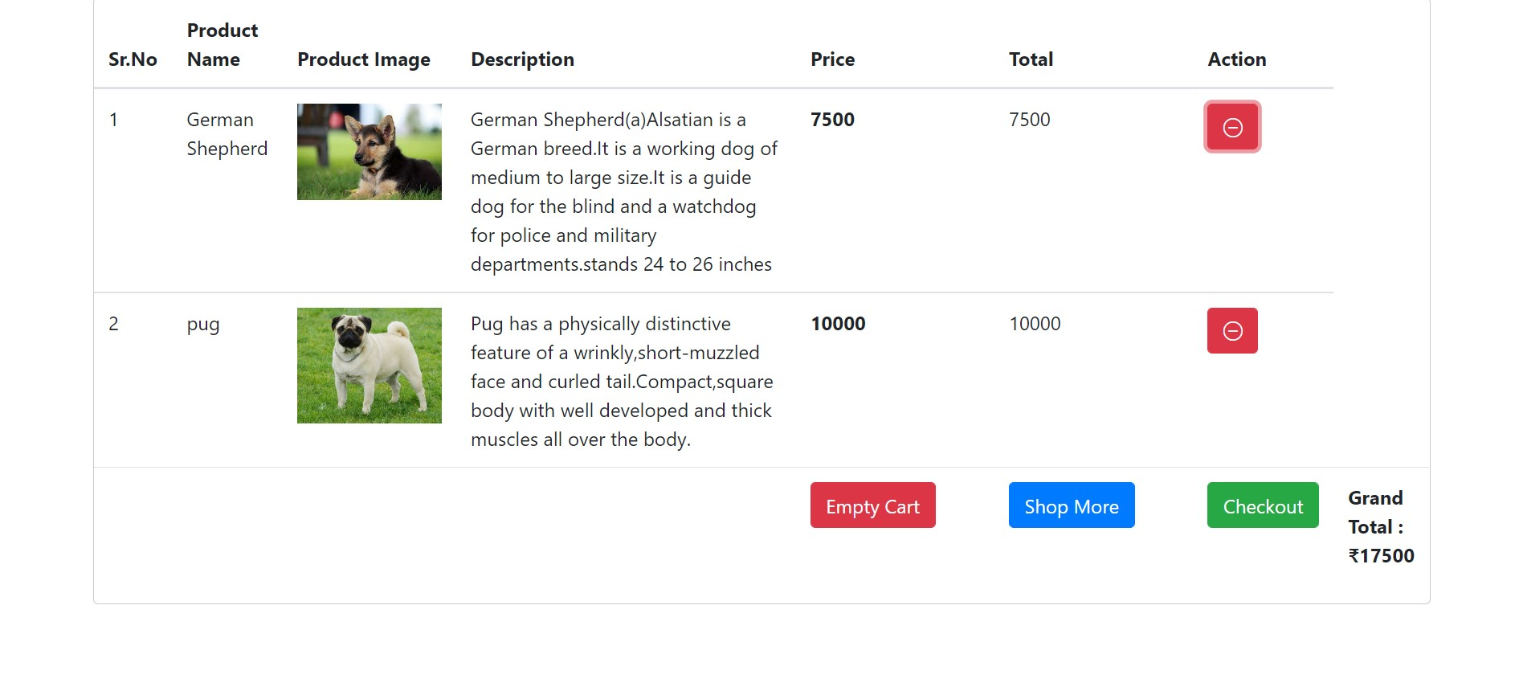
Output Image's

Slide 13
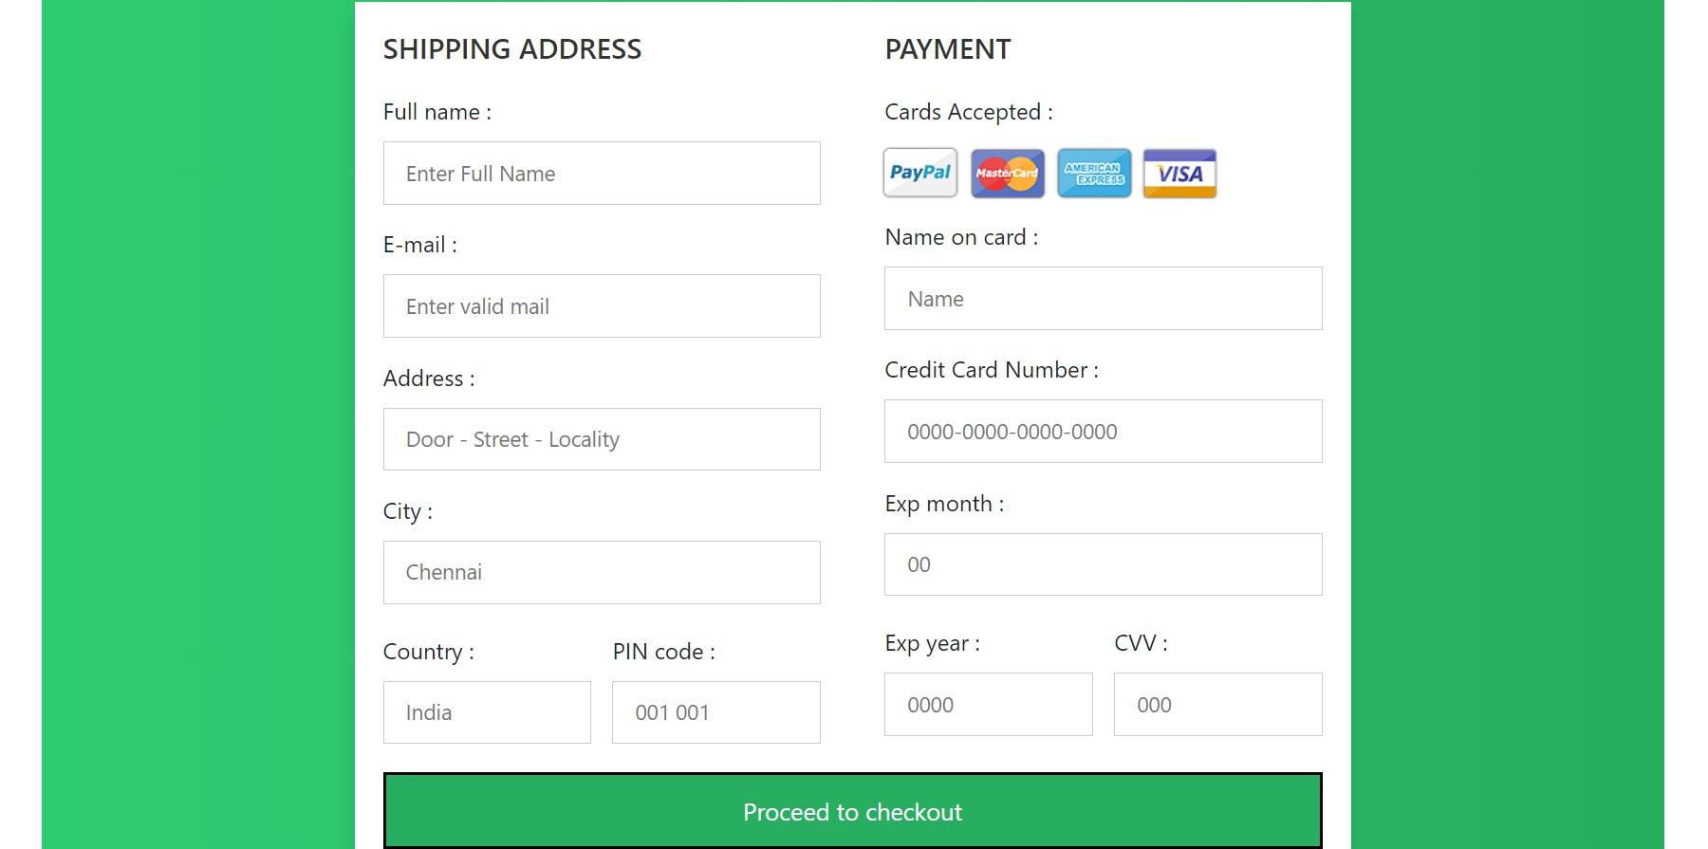
Output Image's

Slide 14
GITHUB LINK
https://github.com/Nishaseelan27/Project-Pet_Paradise.git

Slide 15
CONCLUSION
Pets-paradise, a project that serves as an entry point to the world of computerization's component parts, has undergone a thorough analysis of its designing and development as part of the project. Every requirement that was gathered during the analysis and designing phases of the project has been met. We will create a straightforward framework for purchasing in this project. The project has been designed such that it can be improved in the future in a safe and dependable way. This project's successful completion has boosted my level of creativity, instilled confidence, and given me new knowledge and experience while also extending my capacity for imagination.

Slide 16
REFERENCE
• https://MyPetz.co.in
• https://www.dogspot.in
• https://getvetco.com/pet/store
• https://petsworld.in
• https://www.stackoverflow.com
• https://www.w3schools.com

